Slide 1
API FLOW
BINAR FULLSTACK WEB 32 CHALLENGE 06
AGNES SEPTILIA

Slide 2
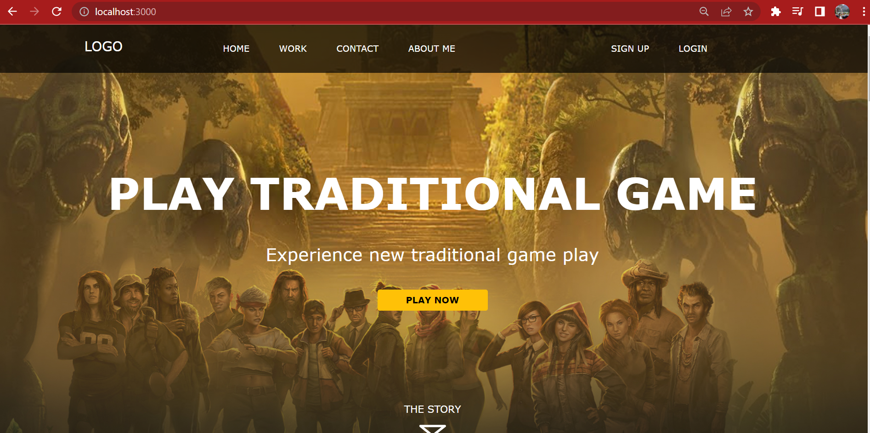
Start adding new data to database using SIGN UP menu

Slide 3
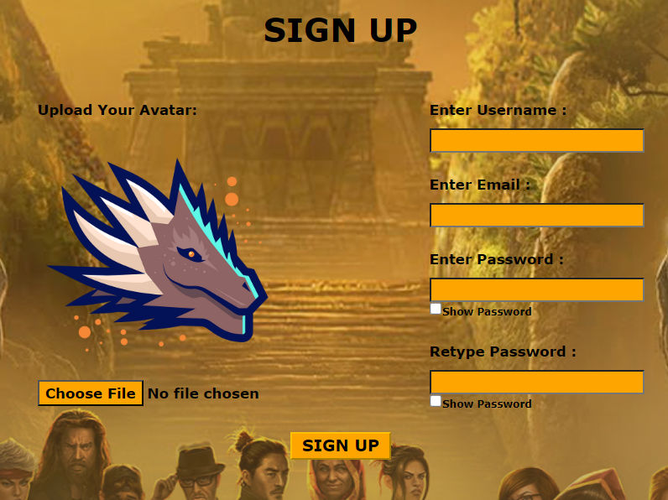
SIGN UP page will require user to put credential information
Data will be stored into table user_games
Error will be happened if:
The email has been available on database (column email is set as unique)
The first password is not match with retype password
Password will be encrypted before entering database

Slide 4
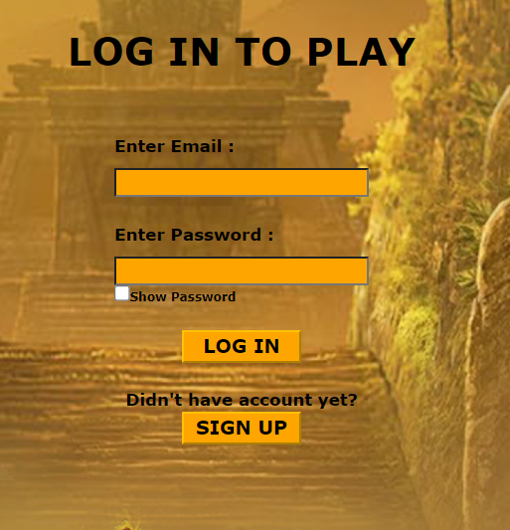
LOGIN page can be opened after user has sign up, OR, if user has had signed up previously, they can enter login page from the main page.
Email and Password will be checked with the database.
Error will happened if:
Email is not found on database
Email is found but password is incorrect
For the sake of simplicity, you can put Email and Password (non-encrypt) for SuperUser in .env file . Program will only compare whether they are match, instead of going through encryption.

Slide 5
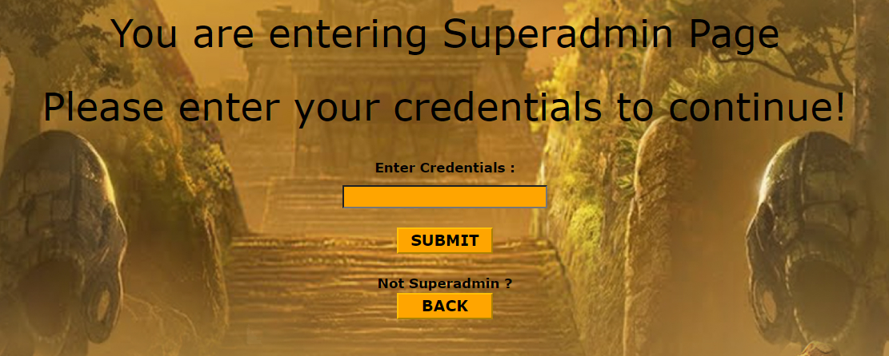
Credential page for Super user
Credential key can be put on .env

Slide 6
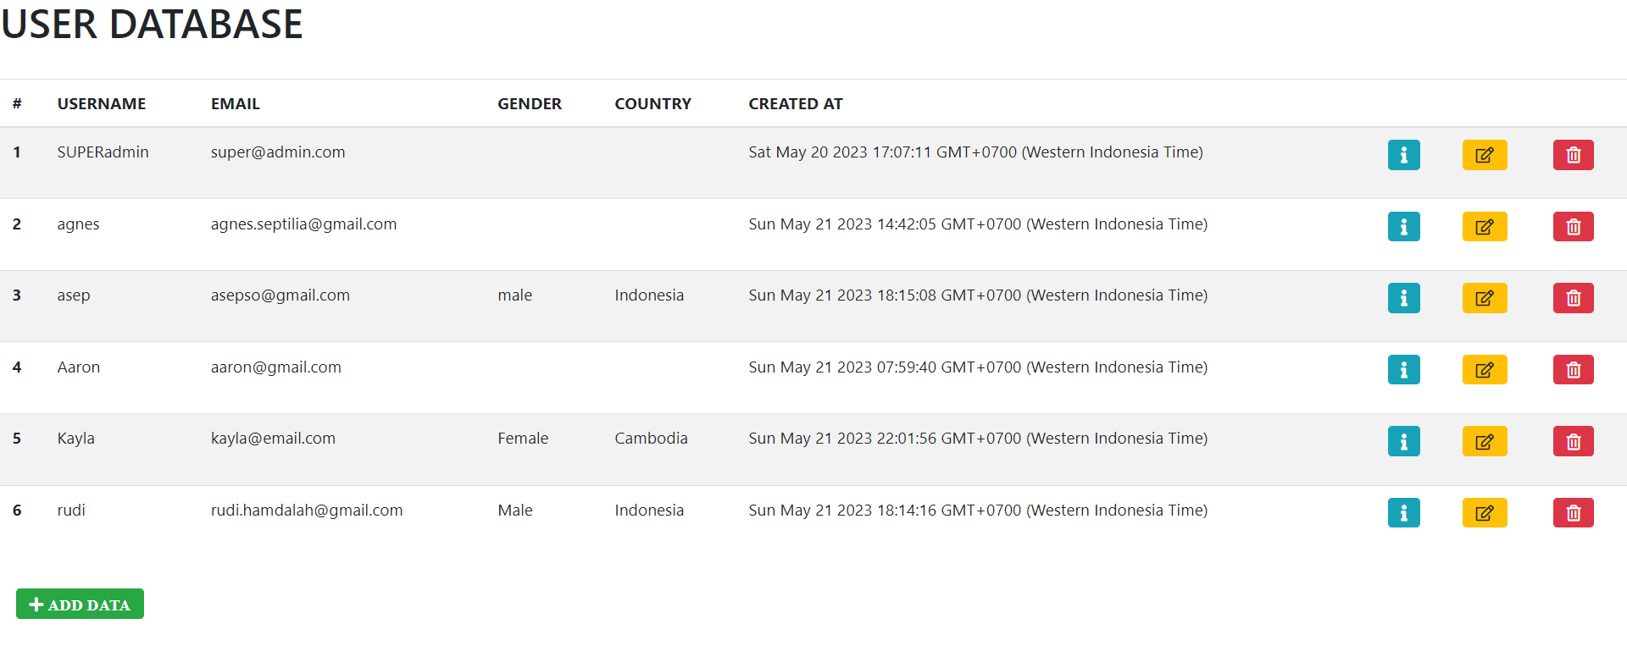
Super admin Page will show data from table user_games and user_games_biodata.

Slide 7
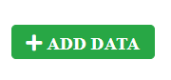
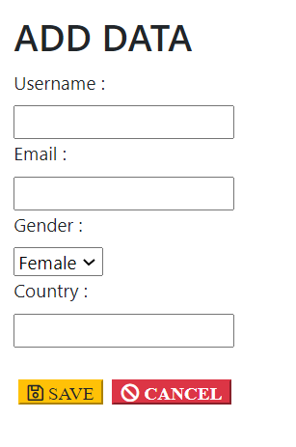
ADD data Button will redirect to new API for adding Data
Only data from user_games and user_game_biodatas can be added through this API
Both Buttons will redirect to Main Superadmin Page. Only if you click save, the new data will be stored and shown

Slide 8

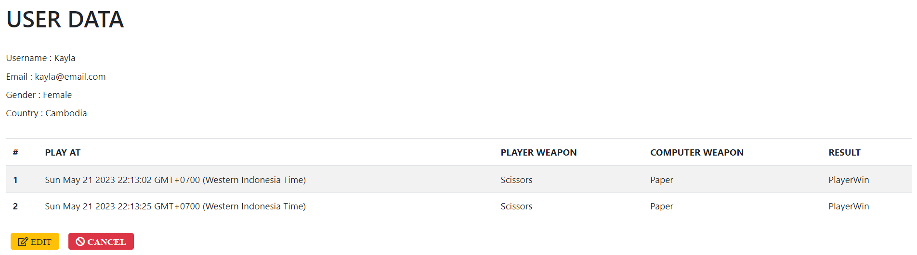
Info button will show the user information, and the history of the game. But no edit is allowed.
The information for biodata and game history are still not integrated with the user side. So the data was updated manually.
If we want to update data, Click Edit Button.

Slide 9

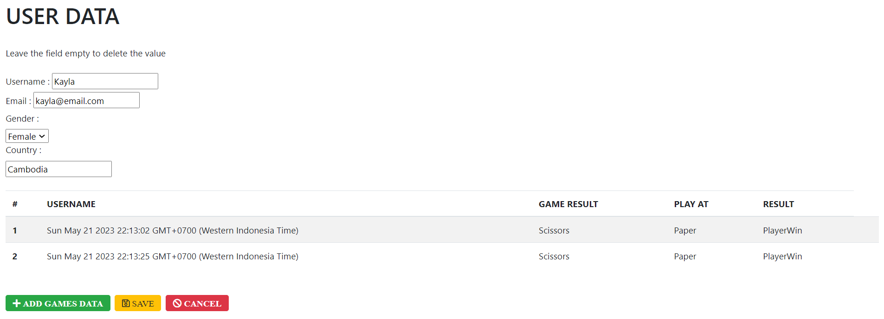
Edit Page can be accessed from Main page, or from Info page
In this page, we can edit user’s information, and add games history data

Slide 10
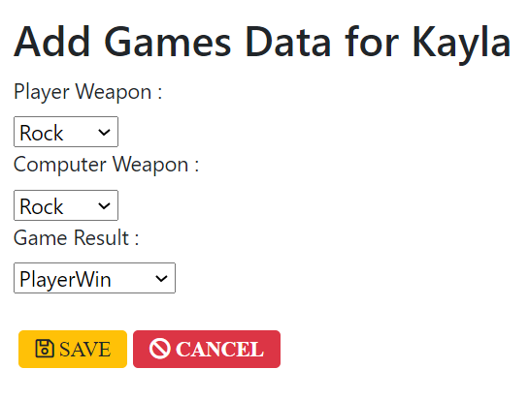
Edit Page can be accessed from Main page, or from Info page
In this page, we can edit user’s information, and add games history data

Slide 11

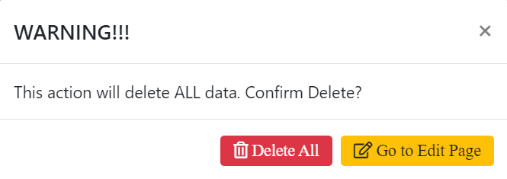
Delete data will show pop-up warning.
Delete All will basically delete all data in all table.
If admin wants to delete few data, they can go to Edit page and leave some fields as empty. This will leave that fields as null on database.

